Slide 1

Impact Framework: Lessor Portfolios

Slide 2

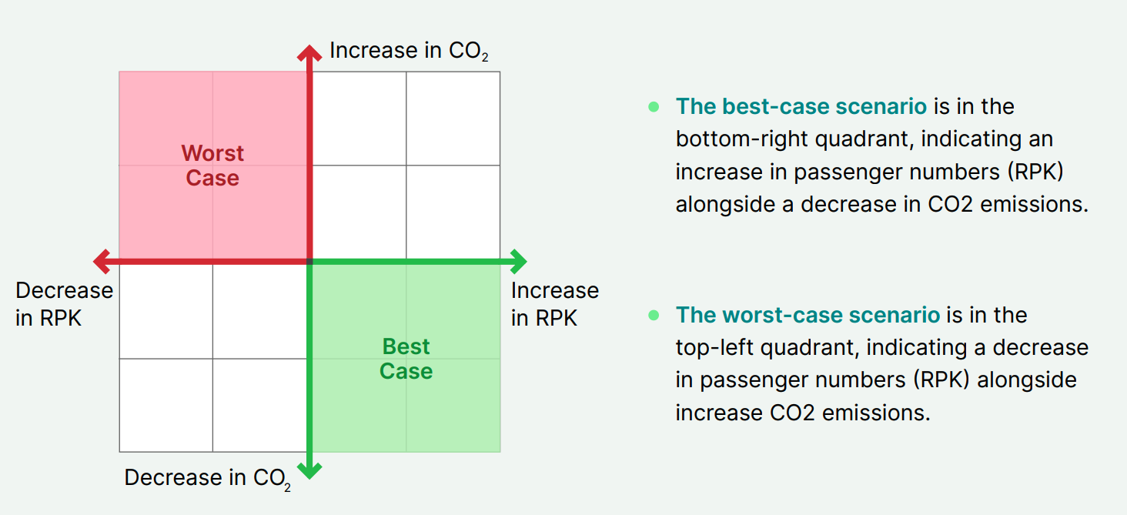
Impact Framework
The Impact framework is used to evaluate airline reported emissions against passenger capacity metrics measured in Revenue Passenger Kilometers (RPK). The variance of these metrics against a baseline year is called “de-coupling’. Each year the level of decoupling can be scored against a pre-defined matrix.
Relative decoupling
Whether total emissions are growing slower than their associated capacity
Absolute decoupling
Whether total emissions are declining as capacity grows
(the ultimate objective).
-3
-2
-1
0
-2
-1
0
1
-1
0
1
2
0
1
2
3

Slide 3
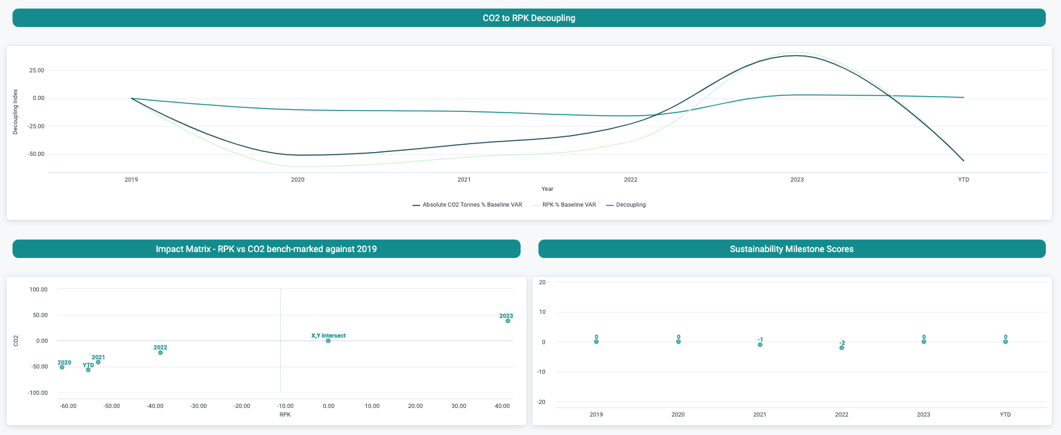
AerCap
 | 2020 | 2021 | 2022 | 2023
Absolute CO2 % VAR | -51.09 | -41.26 | -22.93 | 38.35
RPK % VAR | -61.43 | -53.07 | -38.73 | 41.39
2020 & 2021 saw significant, but relatively consistent falls in both absolute CO2 and passengers carried as a result of Covid.
A milestone score of -2 assigned in 2022 due to the larger fall in RPK vs Absolute CO2.
Positive decoupling achieved in 2023 where growth in RPK was higher than growth in absolute emissions, however the decoupling value not large enough to apply a Score of 1.

Slide 4
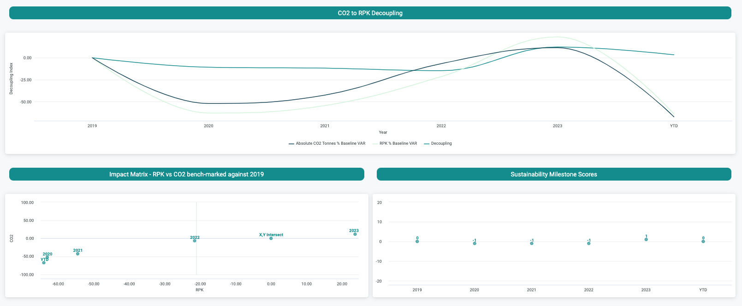
Avolon
 | 2020 | 2021 | 2022 | 2023
Absolute CO2 % VAR | -52.18 | -42.56 | -6.72 | 11.50
RPK % VAR | -63.03 | -54.45 | -21.48 | 23.76
2020 & 2021 saw significant, but relatively consistent falls in both absolute CO2 and passengers carried as a result of Covid.
A milestone score of -1 assigned in 2022 due to the larger fall in passengers carried vs Absolute CO2 against benchmark year of 2019.
Positive decoupling achieved in 2023 where growth in RPK was higher than growth in absolute emissions, which is reflected in a score of 1.

Slide 5
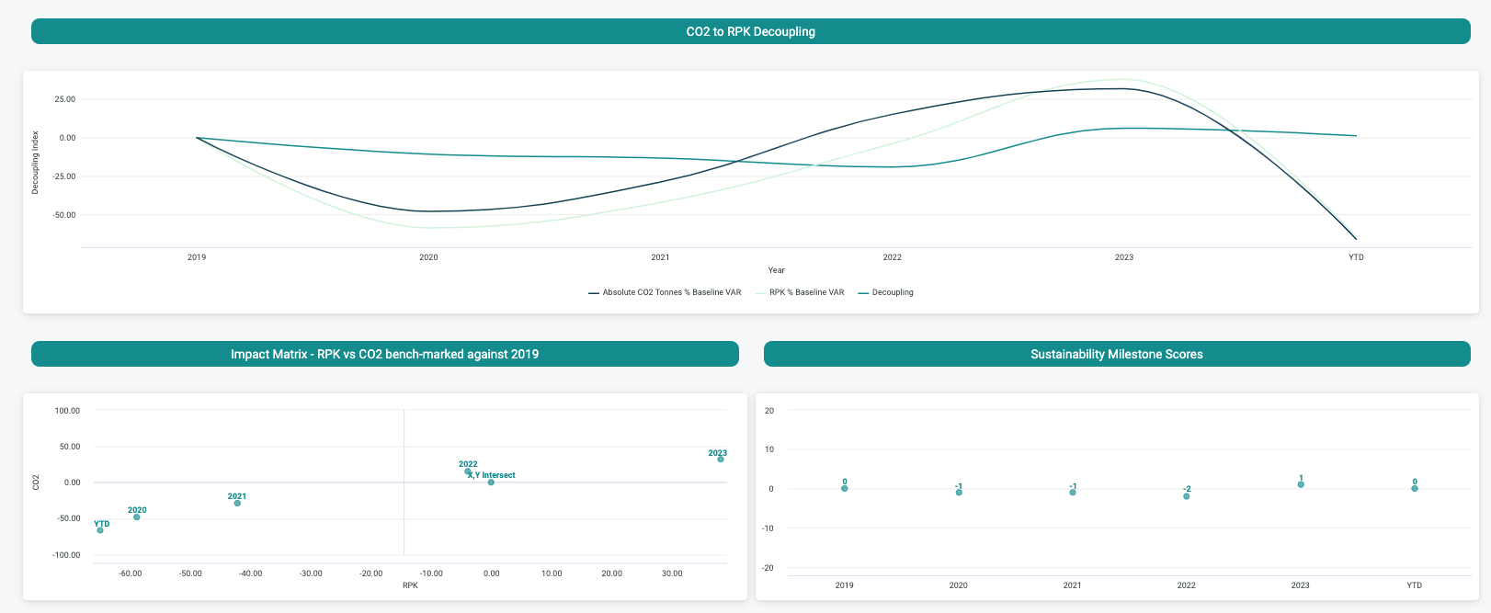
Jackson Square Aviation
 | 2020 | 2021 | 2022 | 2023
Absolute CO2 % VAR | -48.09 | -28.88 | 15.22 | 31.85
RPK % VAR | -58.81 | -42.19 | -3.90 | 38.07
2020 saw significant, but relatively consistent falls in both absolute CO2 and passengers carried as a result of Covid.
A milestone score of -1 assigned in 2021 due to larger fall in passengers carried vs reduction in CO2 to 2019 baseline year.
Positive decoupling achieved in 2023 where growth in RPK was higher than growth in absolute emissions, however the Impact score remained at zero.

Slide 6
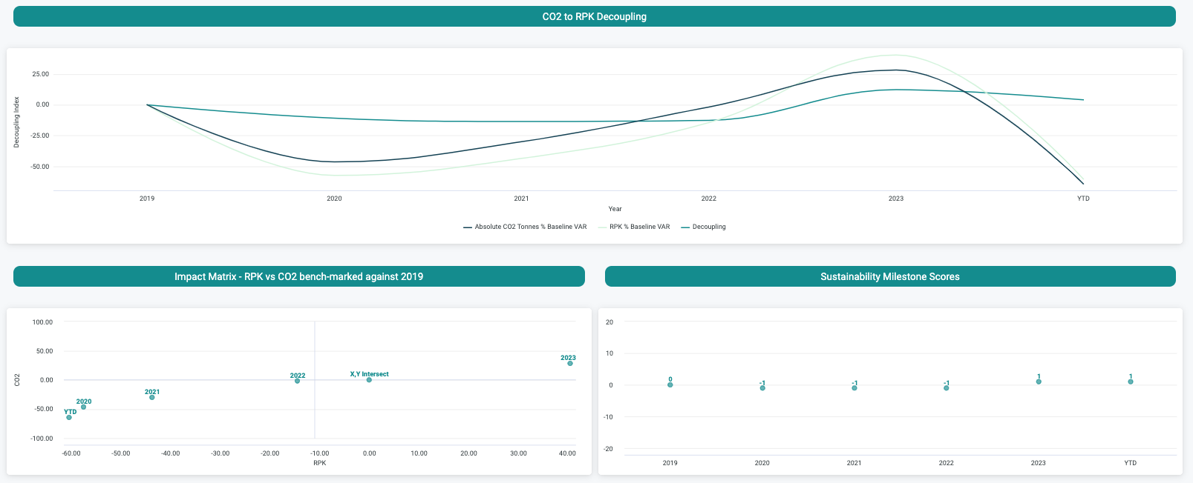
Aviation Capital Group
 | 2020 | 2021 | 2022 | 2023
Absolute CO2 % VAR | -46.47 | -30.05 | -1.79 | 28.25
RPK % VAR | -57.41 | -43.63 | -14.46 | 40.50

Slide 7
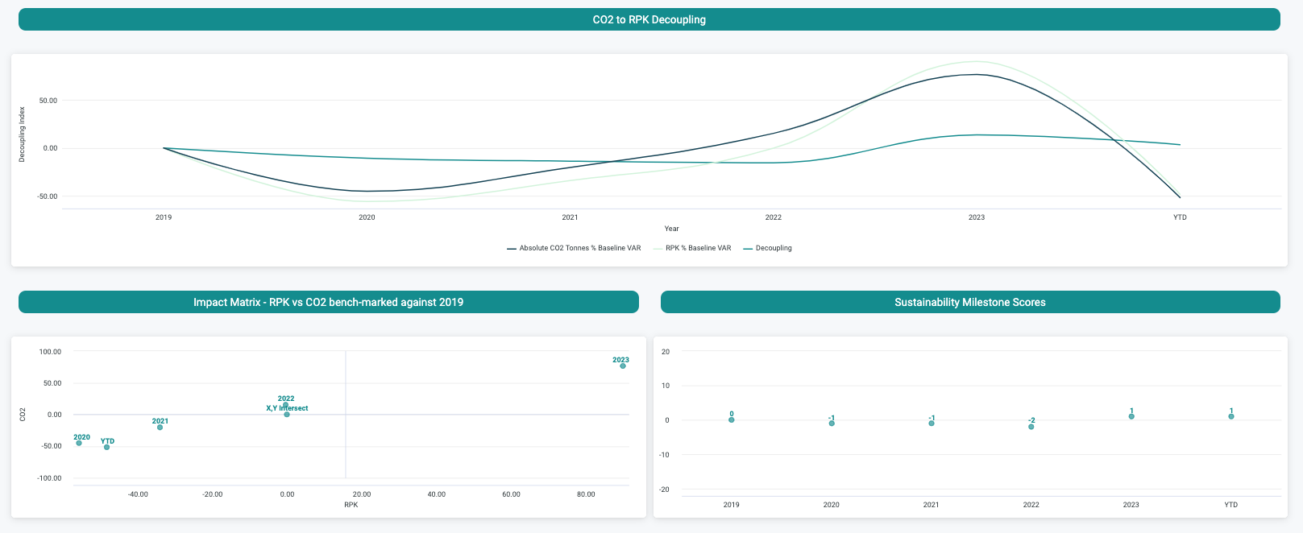
SMBC AC
 | 2020 | 2021 | 2022 | 2023
Absolute CO2 % VAR | -45.07 | -20.24 | 15.17 | 76.50
RPK % VAR | -55.76 | -33.98 | -0.30 | 90.05

Slide 8
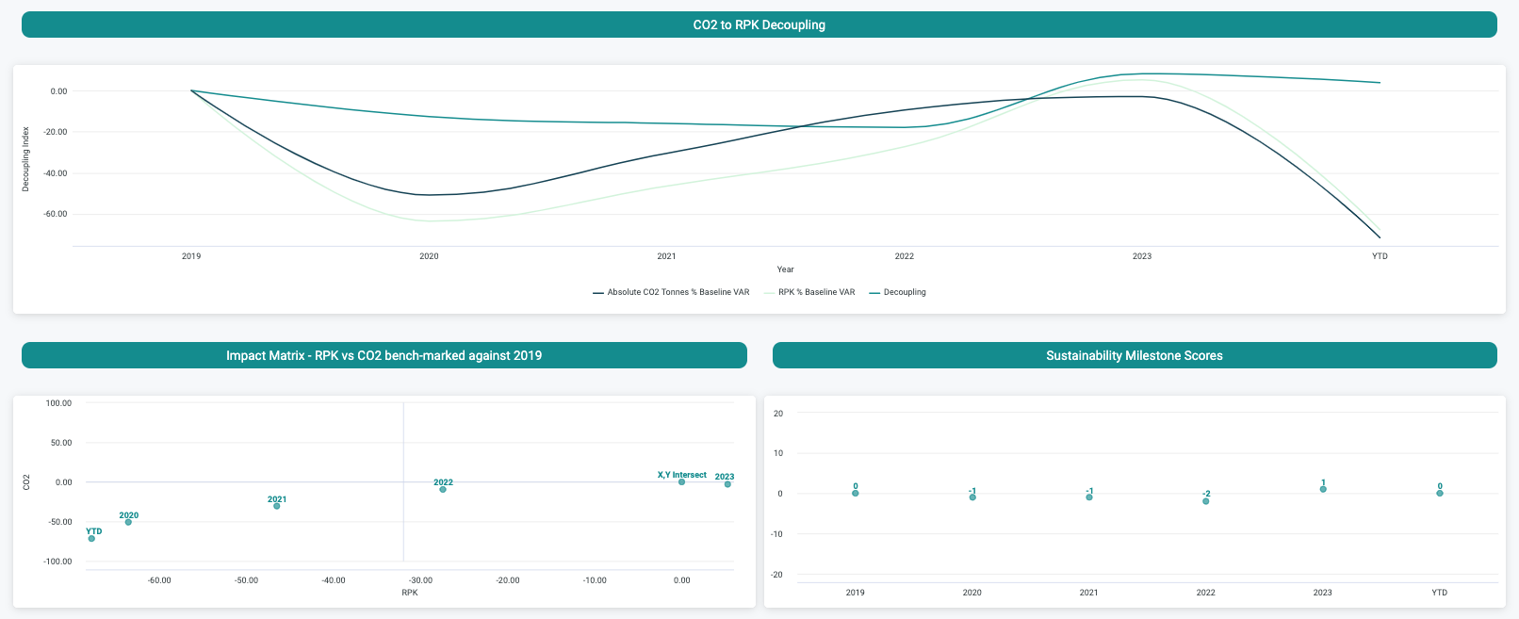
Orix Aviation
 | 2020 | 2021 | 2022 | 2023
Absolute CO2 % VAR | -50.84 | -30.49 | -9.47 | -2.93
RPK % VAR | -63.47 | -46.44 | -27.36 | 5.26

Slide 9
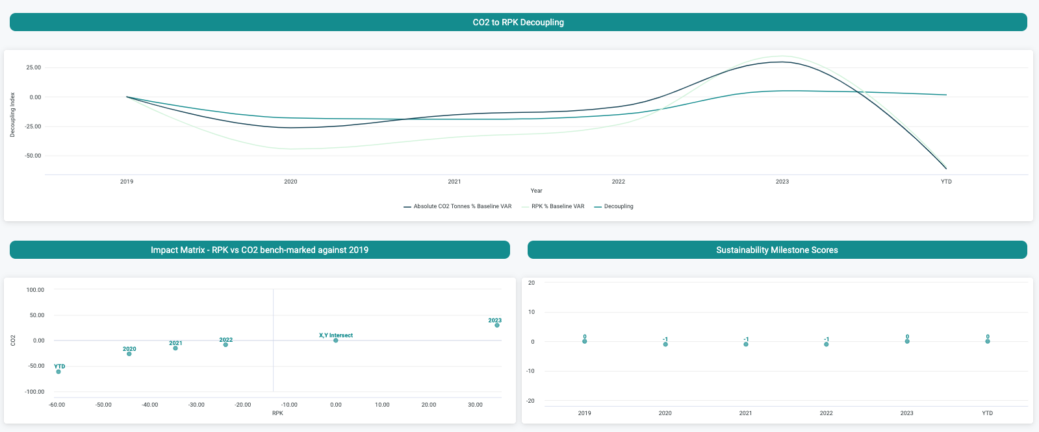
CALC
 | 2020 | 2021 | 2022 | 2023
Absolute CO2 % VAR | -26.37 | -15.29 | -8.43 | 29.65
RPK % VAR | -44.38 | -34.42 | -23.66 | 34.69

Slide 10
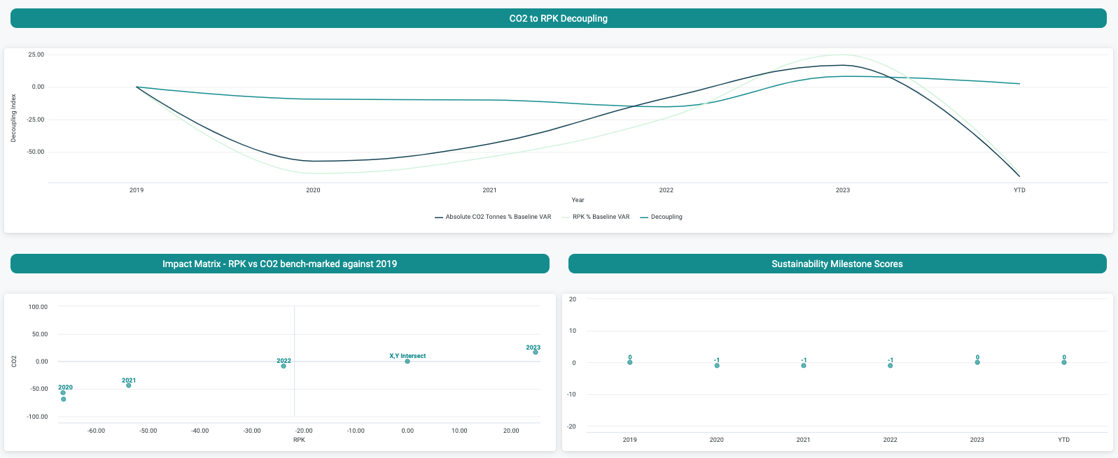
DAE Capital
 | 2020 | 2021 | 2022 | 2023
Absolute CO2 % VAR | -56.97 | -43.68 | -8.62 | 16.59
RPK % VAR | -66.41 | -53.71 | -23.87 | 24.68

Slide 11
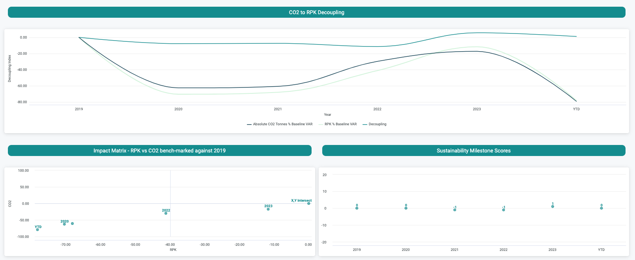
Aircastle
 | 2020 | 2021 | 2022 | 2023
Absolute CO2 % VAR | -62.51 | -60.60 | -29.73 | -17.30
RPK % VAR | -70.31 | -67.96 | -41.09 | -11.65

Slide 12
Q & A

